Slide 1
RUNGTA COLLEGE OF DENTAL SCIENCES AND RESEARCH,BHILAI
CLASSIFICATION OF
PERIODONTAL DISEASES
PRESENTED BY:
Dr pushpendra yadav
Sr. lecturer
Dept. of Periodontology

Slide 2
SPECIFIC LEARNING OBJECTIVES
CORE AREAS | DOMAIN | CATEGORY
Introduction | Affective | Desire to know
Need for classification | Cognitive | Must to know
Historical perspective | Cognitive | Must to know
Chronic periodontitis | Cognitive | Must to know
Aggressive periodontitis Periodontal Diseases | Cognitive | Must to know
Periodontitis as a manifestation of systemic diseases | Cognitive | Must to know
Periodontal abscess 2017 classification | Cognitive Cognitive | Must to know Must to know

Slide 3
CONTENT
Introduction
Need for classification
Historical perspective
Chronic periodontitis
Aggressive periodontitis
Periodontitis as a manifestation of systemic diseases
Periodontal abscess
2017 classification
Summary
References

Slide 4
INTRODUCTION
Periodontal disease is a disease, or more likely a number of diseases of the periodontal tissues that results in attachment loss and destruction of alveolar bone.
Periodontal disease, however, encompasses a wider spectrum of diseases than just periodontitis and the recognition of these diseases requires a diagnosis be made.
Diagnosis is the recognition of the presence of a disease.

Slide 5
HISTORICAL PERSPECTIVE
For many years, particularly in America, periodontitis was known as ‘‘Riggs’ disease’’.
In the 19th century, little was understood about the aetiology and pathogenesis of periodontal diseases.
Classification was made on the basis of their clinical characteristics or theories on their etiology and was unsupported by any evidence base.
The term ‘‘pyorrhea alveolaris’’ was introduced early in the 19th century to describe periodontitis and literally meant ‘‘pus oozing out of the alveolus’’.
This suggested that the bone in periodontitis was infected.
This, unfortunately, was incorrect but influenced treatment of periodontitis for many years toward the removal of infected marginal bone via flap surgery.

Slide 6
Stillman and McCall argued for the terms, gingivitis, ulatrophia, alveoloclasia, and pericementoclasia for disease processes attacking primarily the gingival tissues, the pericementum or the alveolar bone.
There was little agreement or coordination until 1942 when Orban proposed a classification scheme based on the principles of basic pathology. This was accepted by the American Academy of Periodontology (AAP)

Slide 7
In November 1986, the AAP adopted a new classification which embraced these groups as follows:
Juvenile periodontitis
A. Prepubertal periodontitis
B. Localized juvenile periodontitis
C. Generalized juvenile periodontitis
Adult periodontitis
Necrotizing ulcerative gingivo-periodontitis
Refractory periodontitis

Slide 8
A revised classification was given in 1989 which was as follows:
Adult periodontitis
II. Early-onset periodontitis
Prepubertal periodontitis
Generalized
2. Localized
B. Juvenile periodontitis
Generalized
2. Localized
C. Rapidly progressive periodontitis
III. Periodontitis associated with systemic disease
IV. Necrotizing ulcerative periodontitis
V. Refractory periodontitis

Slide 9
This classification was based upon:
Presence ⁄ absence of clinically detectable inflammation.
Extent and pattern of attachment loss.
Patient’s age at onset.
Rate of progression.
Presence ⁄ absence of miscellaneous signs and symptoms, including pain, ulceration and amount of observable plaque and calculus.

Slide 10
CLASSIFICATION – THE CURRENT SITUATION
The 1989 classification and the simplified European classification gained widespread acceptance and use throughout the world.
However, this system has various short-comings such as:
emphasis on age of onset and rates of progression in the classification which was felt to be inappropriate. ‘‘Early onset’’ implies we have knowledge of when the disease started and ‘‘rapidly progressive’’ implies knowledge of the rate of progression which in many cases we do not have.
there was often considerable overlap of disease categories, difficulty in fitting some patients into any of the categories and the classification criteria were frequently found to be unclear or inadequate

Slide 11
A further World Workshop in Periodontics held by the AAP in 1996 did not produce a new classification.
Reasons stated were ‘‘considerable overlap among disease categories, certain patients do not fit in any category and many microbiological and host response features are shared by multiple disease categories’’.
These concerns were further addressed and the classification was revised in 1999 when the International Workshop for Classification of Periodontal Diseases and Conditions

Slide 12
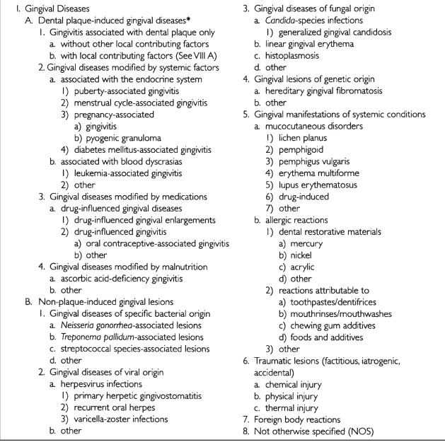

Slide 13
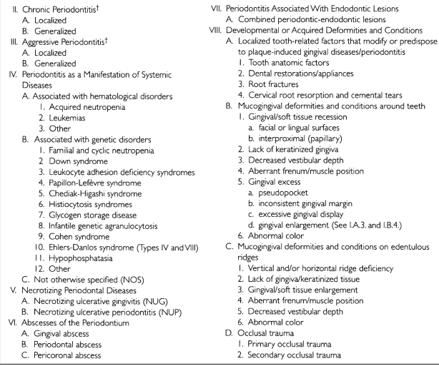

Slide 14
A more convenient and simplified summary is:
Gingival diseases
Plaque induced
B. Non-plaque induced
II. Chronic periodontitis
Localized
B. Generalized
III. Aggressive periodontitis
Localized
B. Generalized
IV. Periodontitis as a manifestation of systemic disease
V. Necrotizing periodontal diseases
VI. Abscesses of the periodontium
VII. Periodontitis associated with endodontic lesions
VIII. Developmental or acquired deformities and conditions

Slide 15
GINGIVAL CONDITIONS
Gingival lesions are classified into two broad categories.
Plaque induced
non-plaque induced.
Dental plaque induced lesions (gingivitis) may be purely plaque related with or without local contributing factors or may be modified by systemic factors, medications or by malnutrition.
although gingivitis has been described as being associated with a periodontium where there has been no loss of attachment, it is possible for gingivitis to occur on a periodontium with a reduced attachment level which is stable and not experiencing progressive loss of attachment.

Slide 18
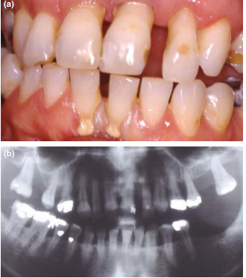
CHRONIC PERIODONTITIS
‘‘Chronic periodontitis’’, in the 1999 classification, has replaced the term ‘‘adult periodontitis’’..
Localized periodontitis is described as 30% or less of sites affected and generalized periodontitis being more than 30% of sites affected.

Slide 19
AGGRESSIVE PERIODONTITIS
Aggressive periodontitis replaces the category ‘‘early onset periodontitis’’ which in the 1989 AAP and 1993 European classifications embraced a number of diseases affecting young patients.
the use of this new term addressed the clinical characteristics of the disease while avoiding the controversial age barrier.
While generally patients in this category would be under the age of 30, it is recognized that older patients may also experience periods of more rapid attachment loss.

Slide 20
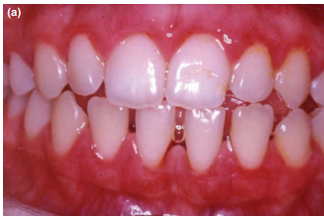
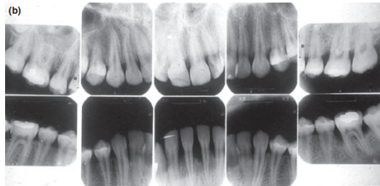

Slide 21
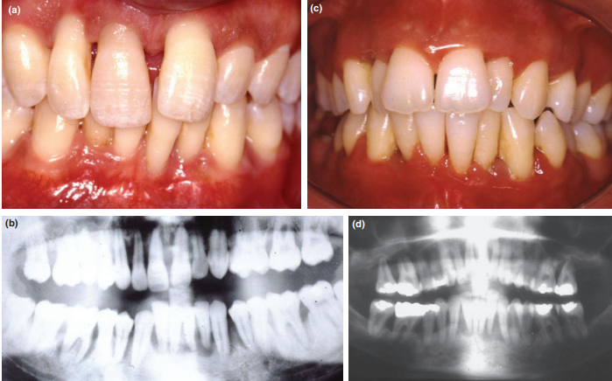

Slide 22
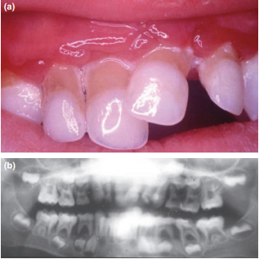
PERIODONTITIS AS A MANIFESTATION OF SYSTEMIC DISEASE

Slide 23
NECROTIZING PERIODONTAL DISEASE
The workshop recognized that necrotizing ulcerative gingivitis (NUG) and necrotizing ulcerative peridontitis (NUP) were clinically distinguishable disease entities but were unsure as to whether they were part of the same disease process or were two distinct diseases.
Necrotizing ulcerative gingivitis tends to be recurrent if predisposing factors remain and progresses to necrotizing ulcerative periodontitis, in some cases causing severe destruction of the periodontal tissues.
This condition is commonly associated also with HIV infection

Slide 25
PERIODONTAL ABSCESS
although periodontal abscess formation is a clinical feature of both chronic and aggressive periodontitis, it presents as a distinct clinical entity that requires specific diagnosis and treatment and thus deserves a separate classification.
In most cases periodontal abscess formation reflects the acute exacerbation of a pre-existing periodontal pocket.
Abscesses may occur because of other causes such as foreign body impaction, trauma, including occlusal trauma causing vertical and horizontal root fractures or cemental tears.

Slide 26
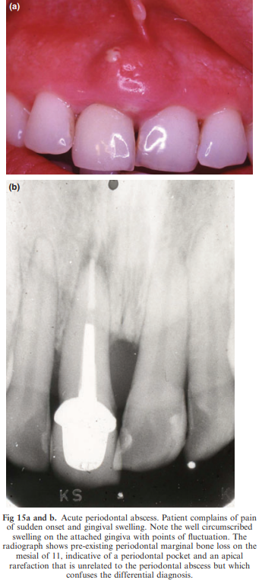

Slide 27
2017 CLASSIFICATION
The American Academy of Periodontology & European Federation of Periodontology in early 2015 planned for a world workshop which was finally held on November 9 to 11, 2017 in Chicago.
The new classification not only classified various diseases, but also provided a structure for treatment planning & for monitoring the patient response to therapy.
This classification also included specifically designed classification for peri-implant diseases and conditions.

Slide 28
CLASSIFICATION AT A GLANCE
PERIODONTAL HEALTH, GINGIVAL DISEASES, & CONDITIONS
Periodontal & gingival health
Gingivitis : biofilm induced
Gingival diseases : Non-biofilm induced.
2. PERIODONTITIS
Necrotizing periodontal diseases.
Periodontitis
Periodontitis as a manifestation of systemic diseases.

Slide 29
3. OTHER CONDITIONS AFFECTING PERIODONTIUM
Systemic diseases or conditions affecting periodontal supporting tissues.
Periodontal abscess and endo-perio lesions
Mucogingival deformities and conditions
Traumatic occlusal forces
Tooth & prosthesis-related factors.
4. PERI-IMPLANT DISEASES & CONDITIONS
Peri-implant health
Peri-implant mucositis
Peri-implantitis
Peri-implant soft & hard tissue deficiencies

Slide 30
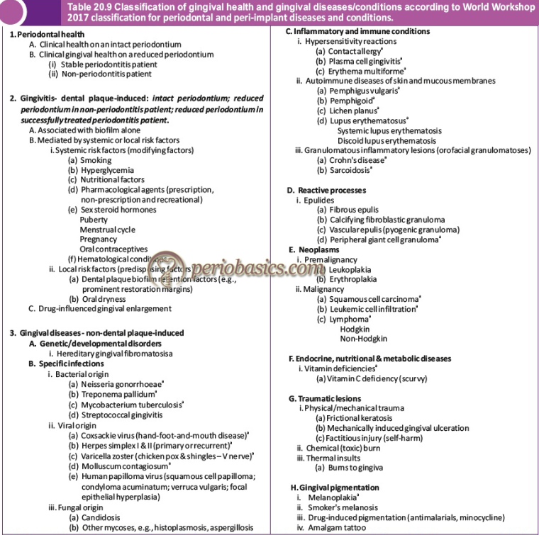

Slide 31
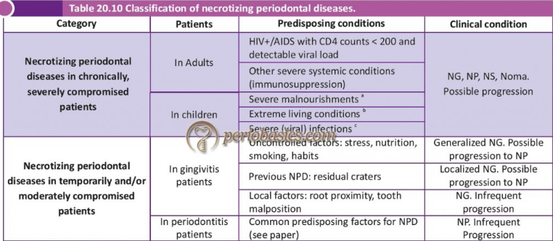
Necrotizing periodontal diseases (NPD)
These are infectious conditions characterized by necrosis of tissues of the periodontium.

Slide 33
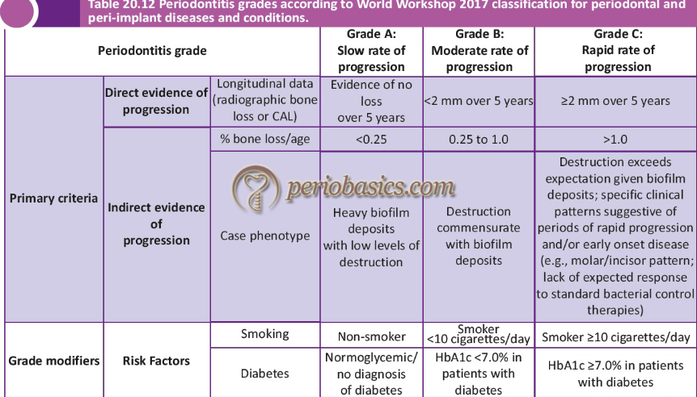

Slide 34
OTHER CONDITIONS AFFECTING PERIODONTIUM

Slide 35
STEPS IN DIAGNOSING PERIODONTITS

Slide 39
SUMMARY
Diagnosis of the disease also involves classification.
Systems of classification are continually evolving.
Classification of periodontal diseases is difficult and all classification systems produced to date have their imperfections and their critics.
Armitage, in a thoughtful article on classification, stated that ‘‘the classification system proposed by the ‘1999 International Workshop for a Classification of Periodontal Diseases and Conditions’ has corrected some of the problems associated with the previous system that had been in use since 1989. Nevertheless, the new system is far from perfect and will need to be modified once there are sufficient new data to justify revisions’’.

Slide 40
REFERENCES
Diagnosis and classification of periodontal disease - J Highfield
Periodontal diagnoses and classification of periodontal diseases – Gary C. Armitage
Carranza’s Clinical Periodontology, 13th Edition
Clinical Periodontology and Implantology by Jan Lindhe, 5th edition
Periobasics

Slide 41
THANK YOU

